Slide 1
Social Media Analytics Text Mining Final Project
Federico Francone Giandomenico Palumbo

Slide 2
Objectives and Dataset
Build a small Opinion Mining system applied to messages from Twitter
The system is expected to
Classify a tweet with respect to a set of classes reflecting a sentiment expressed from the message
Positive, negative and neutral classes
Index each classified message in a Search Engine system
Support the retrieval of messages to derive some “opinion oriented” access to tweets
The dataset of tweets you have been provided contains
a training dataset of 8,654 tweets
a development dataset of 1,502 tweets
a test dataset of 3,787 tweets

Slide 3
Applied Architecture
1
2
Parsing
Input SVM KELP Builder
Tweets
Parsed Tweets
Input Kelp
3
4
SVM KELP
Indexing/Retrieval
Input Kelp
Prediction
IN ORDER TO FIND BEST ACCURACY WE DECIDED TO ACT FIRST ON PHASE 3 (KERNEL CONFIGURATION) AND THEN ALSO ON PHASE 2 (BUILDER CUSTOMIZATION)

Slide 4
1° Approach: find best KELP configurations using given parsing
3
SVM KELP
Phases 1 and 2 are considered as given (given parsed tweets and input KELP builder)
We created a java program in order to perform automatically Model Selection based on:
Different kernels, chosen among the available (Linear, Linear Comb of linear kernels, Polynomial, Radial Bases Functions, Norm..)
The use of iterative grids to tune the hyper-parameters (Cp, Cn, Gamma, PolDegree)
Combinations of the different vectors representations (BOW, BOW_NVJ, BOW_SMILE)

Slide 5
The Java Script-1
THE GRIDS AND THE CYCLES – java code examples
List<String> kernels = Arrays.asList("norm", "lin-comb", "poly", "rbf", "Lin-comb2", "Lin-comb3"); List<Float> cps = Arrays.asList(0.1f, 0.5f, 0.75f, 1.0f, 1.25f, 1.5f, 1.75f, 2.0f); List<Float> cns = Arrays.asList(0.1f, 0.5f, 0.75f, 1.0f, 1.25f, 1.5f, 1.75f, 2.0f); List<Float> gammas = Arrays.asList(0.1f, 0.5f, 1.0f, 1.5f, 2.0f);
………
……..
for ( Float x : gammas) { for (Float y : cps) { for (Float z : cns) { gamma = x; cp = y; cn = z; System.out.println("Kernel Rbf"+" gamma:" + x+" cp:"+y+" cn:"+z+" cicle:"+count);

Slide 6
The Java Script-2
THE SELECTION OF THE KERNELS – EXAMPLE OF LINEAR COMBINATION
else if (kernelType.equalsIgnoreCase("lin-comb2")) { String vectorRepresentationName = "polb"; Kernel linearKernel = new LinearKernel(vectorRepresentationName); Kernel normalizedLinearKernel = new NormalizationKernel(linearKernel); //String vectorRepresentationName2 = "bow_nvj"; //Kernel linearKernel2 = new LinearKernel(vectorRepresentationName2); //Kernel normalizedLinearKernel2 = new NormalizationKernel(linearKernel2); String vectorRepresentationName3 = "pol_smiles"; Kernel linearKernel3 = new LinearKernel(vectorRepresentationName3); Kernel normalizedLinearKernel3 = new NormalizationKernel(linearKernel3); LinearKernelCombination combination = new LinearKernelCombination(); combination.addKernel(1.0f, normalizedLinearKernel); //combination.addKernel(1.0f, normalizedLinearKernel2); combination.addKernel(0.5f, normalizedLinearKernel3); usedKernel = combination;

Slide 7

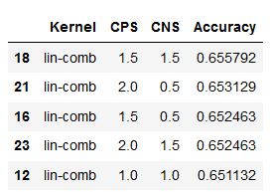
Results of 1st approach
Example of iterative Grid initial parameters = P= [1, 10, 100] step 1: best parameter =10 step 2 : P= [8, 10, 12] → best P= 12 3) P= [11, 12] ……. ……. …… STOP when improvement in accuracy not significant
Specific case: - First set of Cp and Cn: [0.01, 0.1, 1.0, 10]→ best 1.0 - Final set of parameters Cp and Cn: [0.2, 0.5, 1.0, 1.5, 2]
Best model found: Cp=Cn= 1.5, model= lin-comb (0.5 bow+ 1.0 bow_nvj) → accuracy= 65,6%

Slide 8
The need of operating at phase 2, changing the input to Kelp
2
Input SVM KELP Builder
Weaknesses of the given builder:
Independence of words in the BOW representation
Uniform evaluation of the tokens (all set to 1.0)
Moreover the builder does not consider any sentiment associated to single tokens, including SMILE TAGS
An example of the output of the provided Builder:
negative |BS:tweet| Uh drunk and tired and just remembered I 'm going to Ireland in the morning and need to pack . Ireland SMILE_SAD |ES| |BV:bow| _uh:1.0 _drunk:1.0 _and:1.0 _tired:1.0 _just:1.0 _remembered:1.0 _i:1.0 _'m:1.0 _going:1.0 _to:1.0 _ireland:1.0 _in:1.0 _the:1.0 _morning:1.0 _need:1.0 _pack:1.0 _.:1.0 _smile_sad:1.0 |EV| |BV:bow_nvj| _drunk:1.0 _tired:1.0 _remember:1.0 _be:1.0 _go:1.0 _ireland:1.0 _morning:1.0 _need:1.0 _pack:1.0 _smile_sad:1.0 |EV| |BV:bow_smiles| _smile_sad:1.0 |EV|

Slide 9
2nd Approach (FASE 1): customize the input KELP Builder developing a Polarity-Based Model
2
Input SVM KELP Builder
Our IDEA
Rather than uniformly weighting words when they occur (with 1.0), assign them a polarity value based on:
A Polarity Lexicon (Castellucci et al, 2016)
Sentiwordnet (to assign polarity to words not present in the previous lexicon)
Build a custom Polarity Dictionary for the SMILE-TAGS
Build new vector representations considering bi-grams and tri-grams
Combinations of above improvement are then used to train the KELP SVM

Slide 10
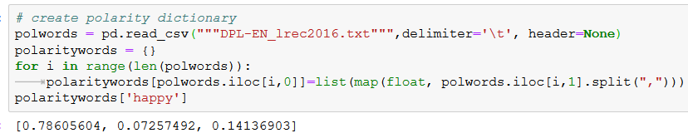
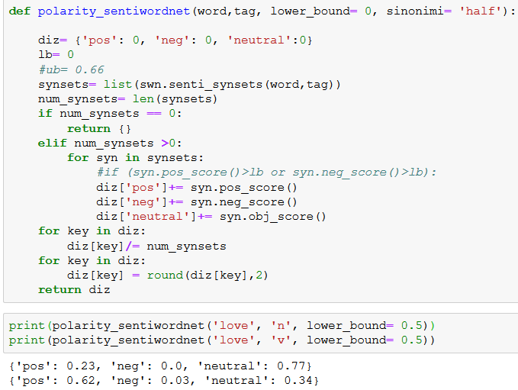
Polarity-Based-Model (FASE 1): Preprocessing (1)
1
Map the Polarity Lexicon to a dictionary {“word”: [polarities]}, (Example in Fig. 1)
Lower all tweets (so that all tokens match a word in lexicon)
Calling SentiWordnet library in Python and defining function that: 3.1 take a word and its synonyms 3.2 compute the word polarity as the average polarity of the synonyms (Example in Fig. 2)
2

Slide 11
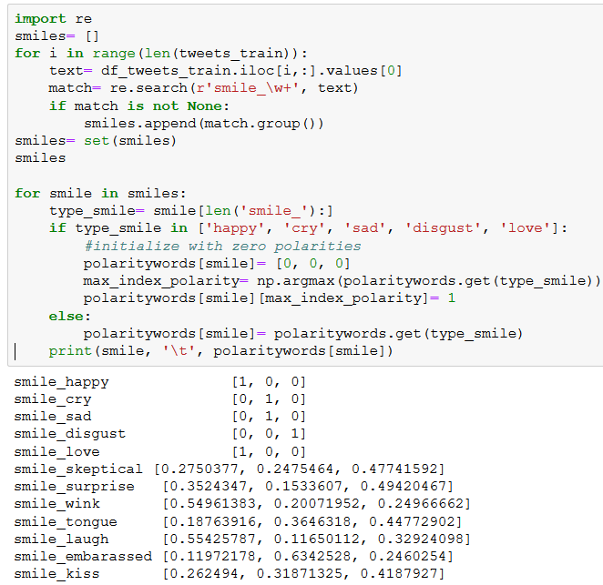
Polarity-Based-Model (FASE 1): Preprocessing (2)
Insert Polarities of SMILES into Polarity Lexicon: 4.1 Extract all kinds of smiles with regular expressions 4.2 Add polarity values to each kind of smile. Assumptions: - happy and love 100% positive - cry, disgust and sad 100% negative - to the others smiles, use polarities in the lexicon

Slide 12
Polarity-Based-Model (FASE 1): Algorithm
Kelp’s input parsing algorithm
1) for each sentence, get lemmas with CoreNLP parser
2) For each lemma with more than 2 characters (assumption), try a) to get polarity from the lexicon b) if above fails, to get it from sentiwordnet (see next slide)
3) Define a threshold (we choose 0.5) under which no polarity is assigned. Then, If max polarity score> threshold, assign to the word: score with sign “+” if positive score with sign “-” if neg 0 if neutral or polarity < threshold

Slide 13

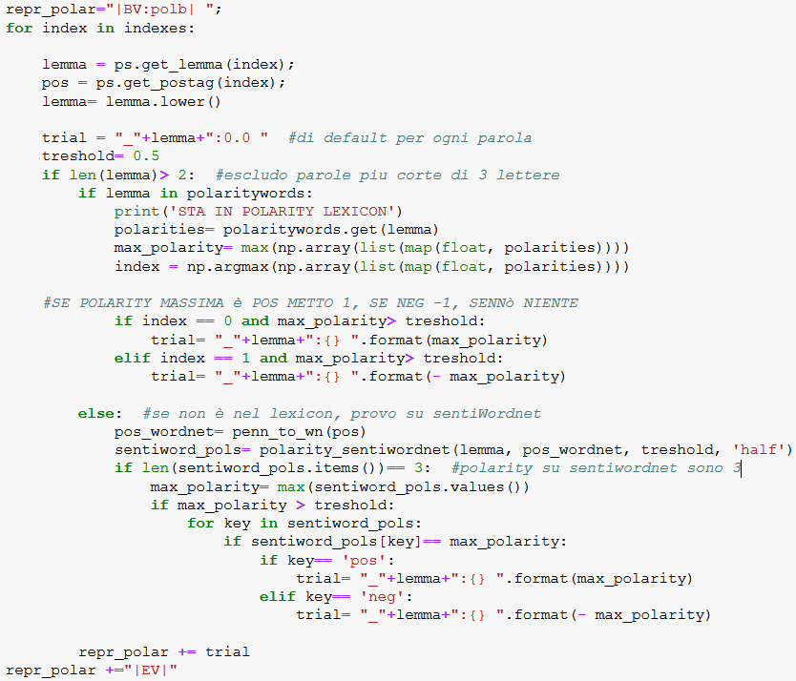



Kelp input parsing algorithm
The Output is a new input Kelp representation: “Polb”

Slide 14
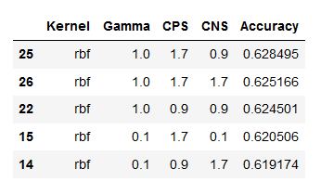
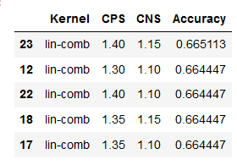
Polarity-Based model performances
Again used Iterative Grid Search approach zooming around best value of the previous step
Simplelin Kernel: best Accuracy= 64,9% for Cp=Cn=1
Kernel poly Acc< 60%
Final Grid Kernel RBF 62.8% →
Best Model: Cp= 1.4, Cn= 1.15, kernel= (0.5 Polb + 1.0 bow_nvj) → BEST ACCURACY= 66,51%

Slide 15
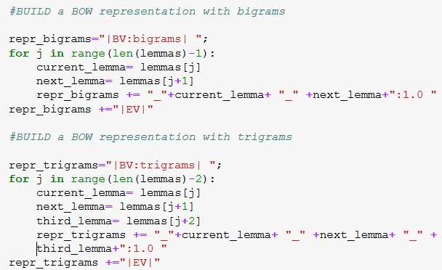
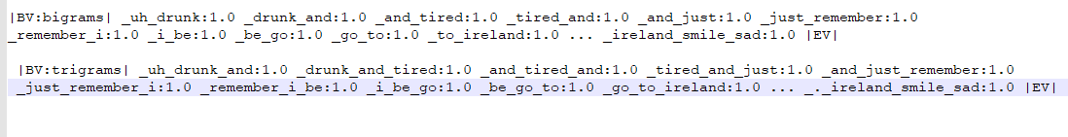
Adding Bigrams and Trigrams vector representations
Windows of 2 words (bigrams) and 3 words (trigrams) to try to reduce independence of individual words
Best acc bigrams: 63.6%, with Cp=Cn=0.8 and combined kernel= 0.5 bigrams + 1.0 bow_nvj
Best acc trigrams: 62.5%, normalized kernel.
Adding none of them gives any improvement in performance

Slide 16
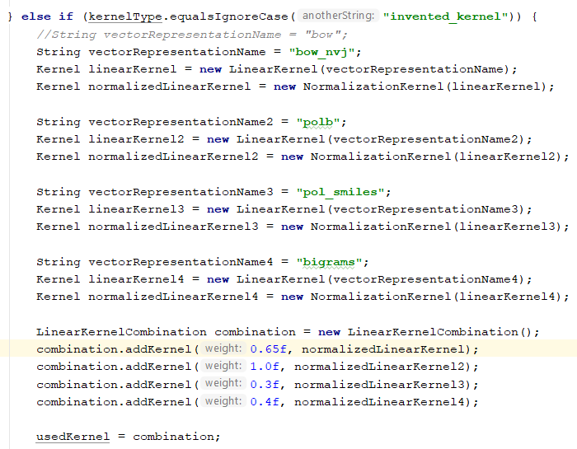

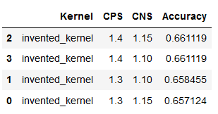
Polarity-based Model FASE 2: Personalized Kernel combination
New kelp representation exclusively with polarity of smiles: we took off smiles’ polarities from the POLB representation and put it separated pol_smiles →
This way we can play much more with the weights in a new combined kernel model. Smiles have their own weight!
Most performing customized kernel is function of: - bow_nvj - polb - pol_smiles - bigrams
Best accuracy: 66,1%

Slide 17
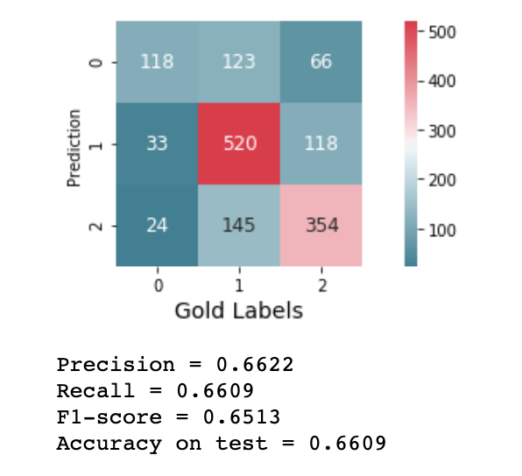
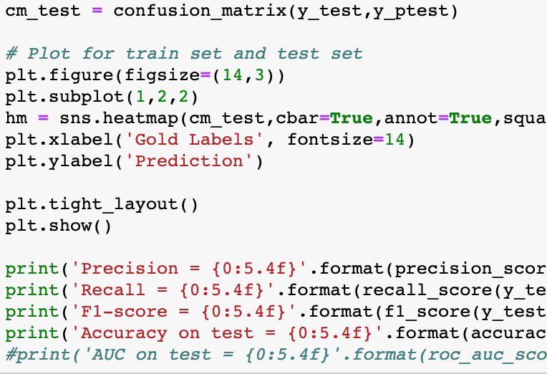
Accuracy, Precision and Recall
Negative Neutral Positive
Negative
Neutral
Positive

Slide 18
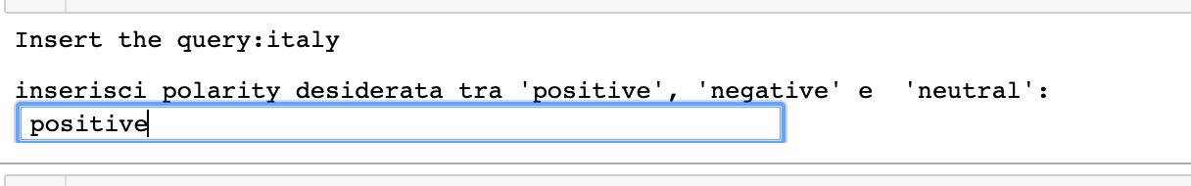
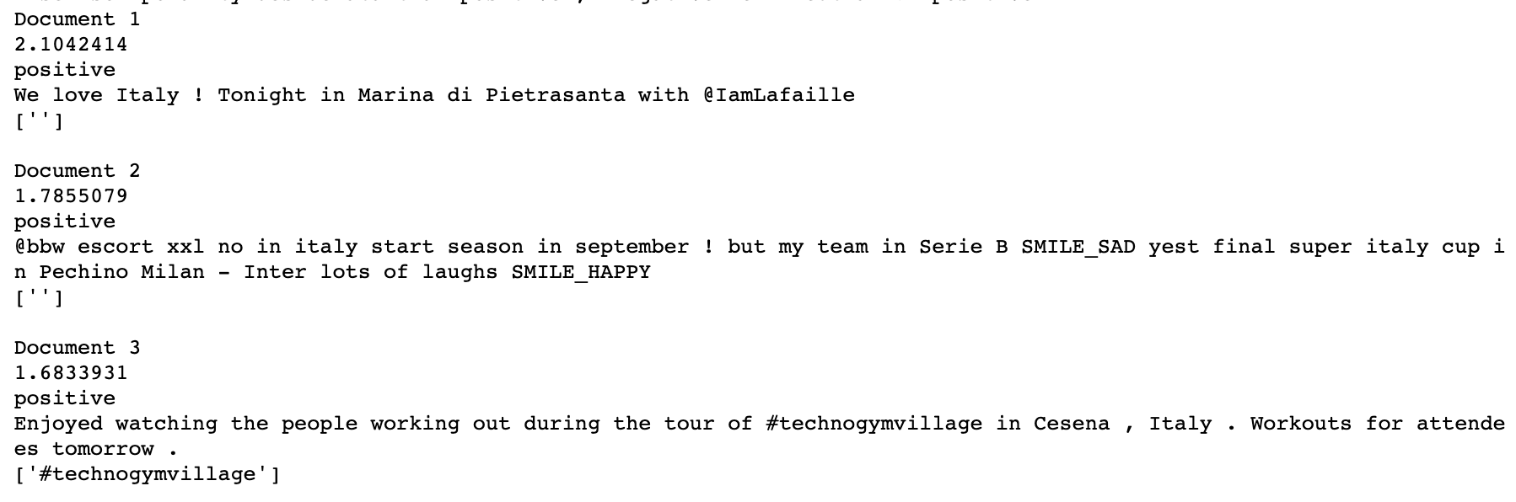
Indexing and Querying with Lucene
We built a very simple interface to insert the queries and filter on the polarity that the user wants to extract

Slide 19
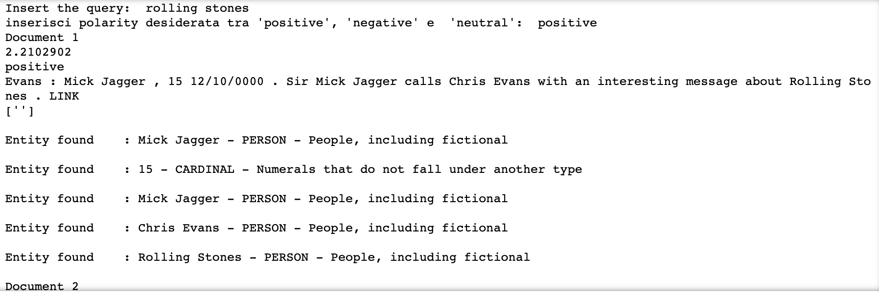
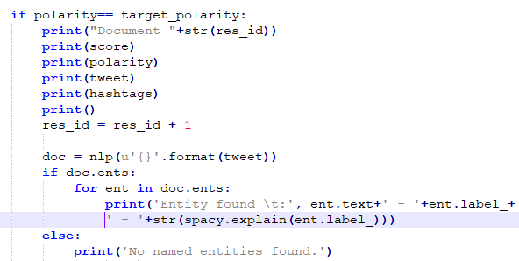
Indexing and Querying with Lucene
We exploited Spacy library to extract Name Entities from Tweets

Slide 20
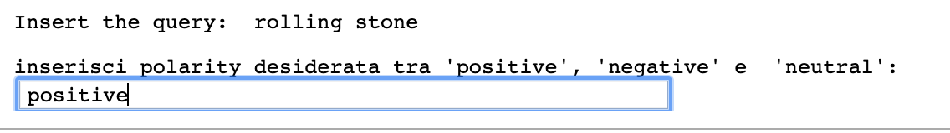
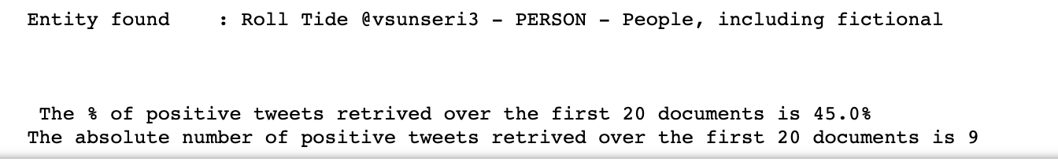
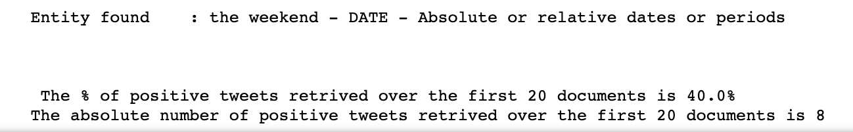
Indexing and Querying with Lucene
For the dev dataset we created an index with the Oracle label and an index with the predicted label to check differences
ORACLE RESULT
PREDICTED RESULT

Slide 21
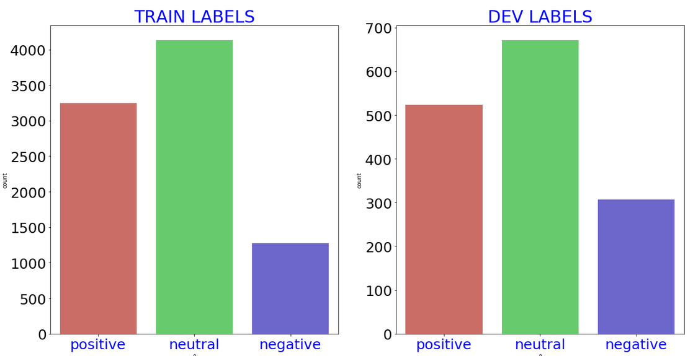
Conclusions
Potential improvements of our model:
Cp and Cn strongly depend on distribution of labels. We found best Cp=1.4, Cn=1.15, but what for a new set of tweets with more negative labels tha positive?
Assumptions and hyperparameters: - different treshold for polarity - playing around with weights in customized kernel (too many combinations) - try other smiles’ polarities and other stopwords (we used len(word)<3)

Slide 22
Thanks for your attention!

